Slide 1
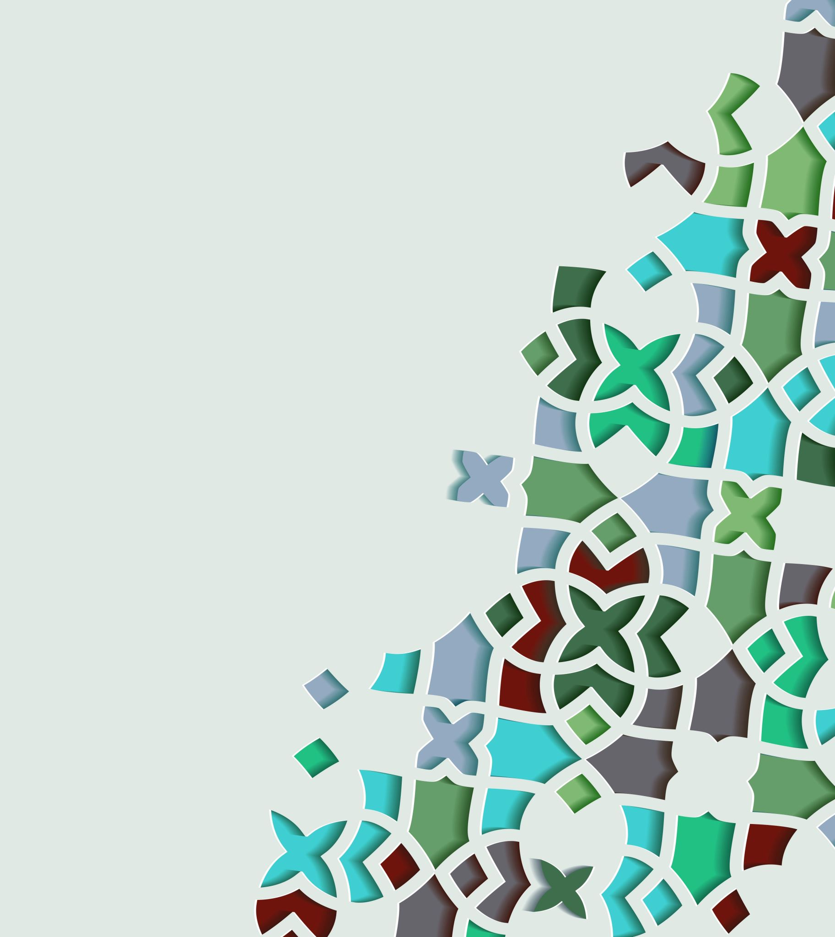
Auto Layout and Responsive UIs 2
2022/4/13

Slide 2
Last week we've learned about the basic components of Constraints namely alignment and pinning, and we’re ready to move on to are more complex interface which is our Main.storyboard.

Slide 3
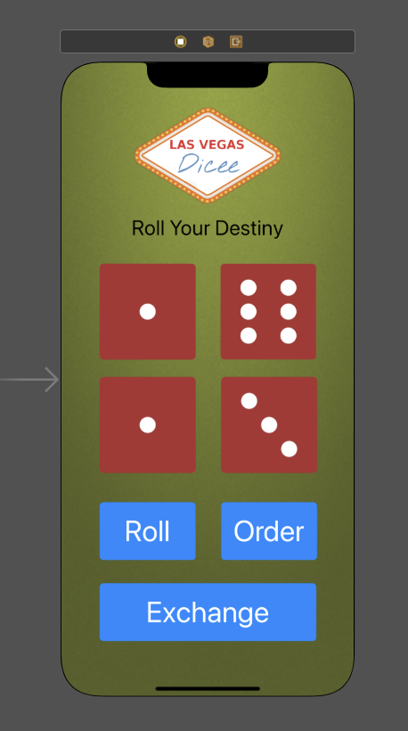
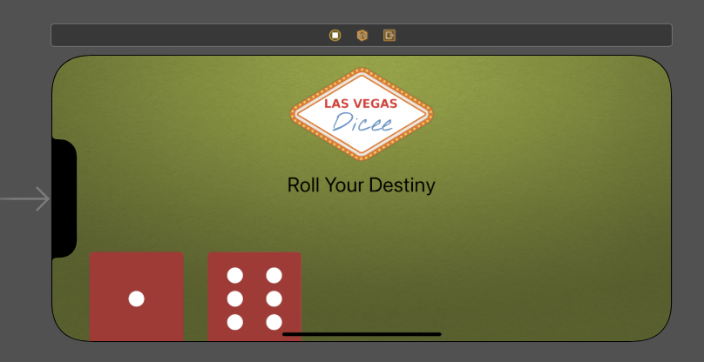
Last Week’s Challenge
Add some constraints to a new label to make it centered in the horizontal axis, but make sure it's also about 15 pixels below the dice logo even when we turn to landscape.

Slide 4
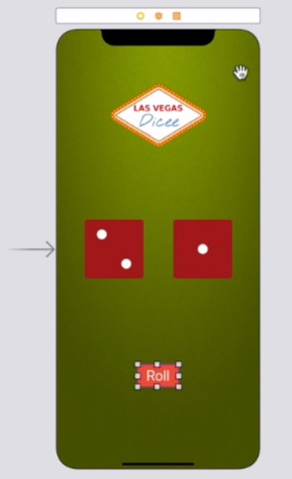
The Next Part Gets Harder
Think About The Four Elements in Our App…

Slide 5
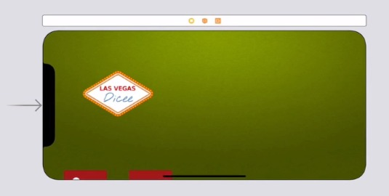
Problem
How are we going to layout all four of these elements on screen in this layout and make sure that it looks decent in the landscape orientation as well.

Slide 6
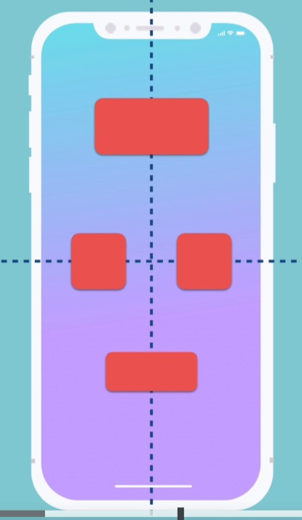
We can't simply just use alignment because we don't have anything that's right in the middle of our screen.
There's nothing that exists here.

Slide 7
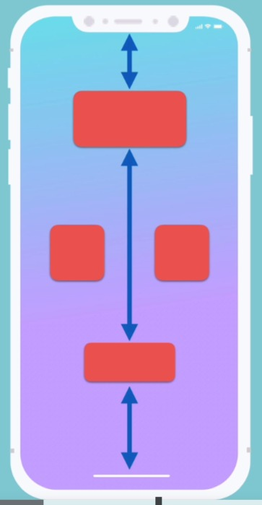
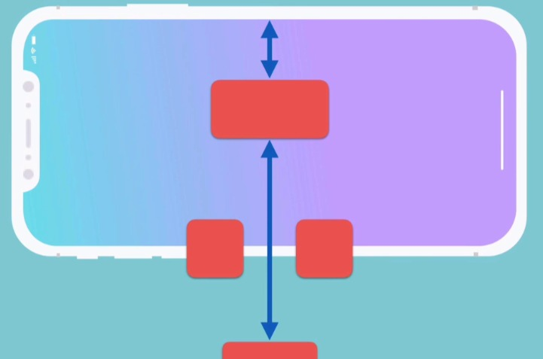
If we wanted to use pinning, well, we don't have enough vertical space to be able to pin all our elements together.

Slide 8
Solution 1 - Immutable
Most Apps adopt this way…
Simple, but not user friendly.
X
X

Slide 9
Solution 2 – Dynamic Constraints or Layouts
@objc func orientationChanged(notification: NSNotification) {
let deviceOrientation = UIApplication.shared.statusBarOrientation
switch deviceOrientation {
case .portrait:
fallthrough
case .portraitUpsideDown:
print("Portrait")
self.applyPortraitConstraints()
case .landscapeLeft:
fallthrough
case .landscapeRight:
print("landscape")
self.applyLandscapeConstraints()
case .unknown:
print("unknown orientation")
@unknown default:
print("unknown case in orientation change")
}
}
Most suitable for every situation but needs lots of programming.
We will discuss this solution in further lesson.

Slide 10
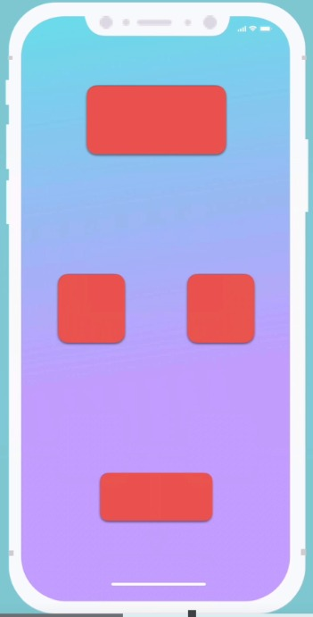
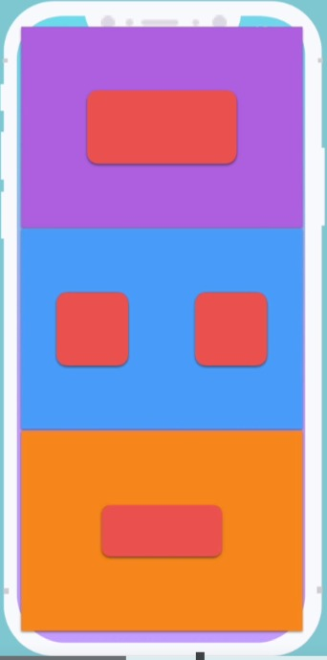
Solution 3 – Containers (Auto Layout)
Easiest way to provide user friendly interface.
We could use some containers to split up the screen into several parts, and then we can embed each of these elements inside its own container

Slide 11
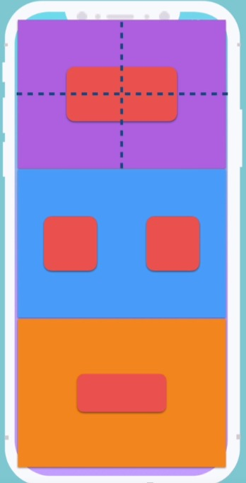
How Container Helps the Auto Layout?
The superview to the item inside a container will be the container itself.
we can set it to be vertically and horizontally aligned in the middle of that container.

Slide 12
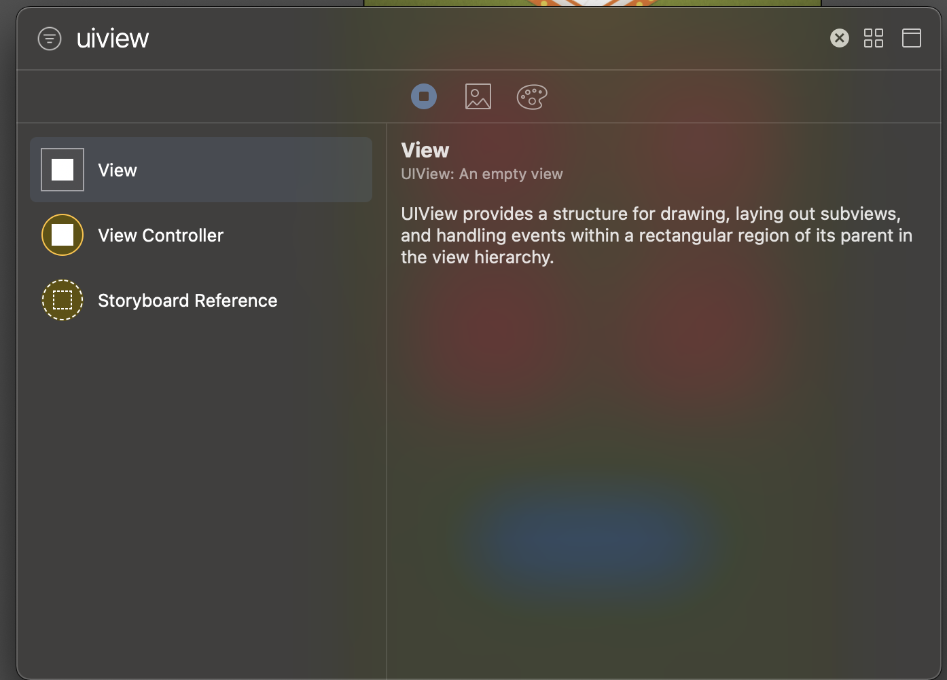
Creating A Container
All we need to do is go to our Object library and locate a view element.
There's a lot of things that are called views, Table View, Image View, Progress View, it's usually easier to type uiview which is the underlying element here.

Slide 13
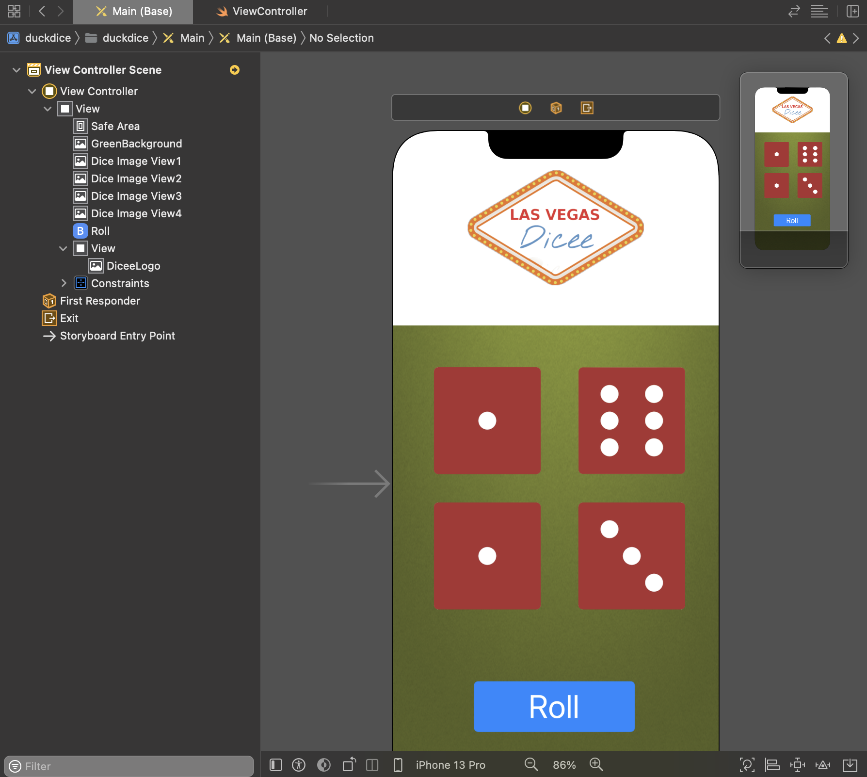
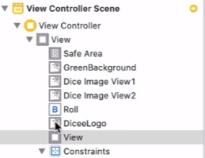
Put Elements into Containers
Firstly, we need to embed the Dicee logo inside this new view.
Click and select Dicee logo, and then drag it, so that this little circle here is indented below the view.
drag into the new view

Slide 14
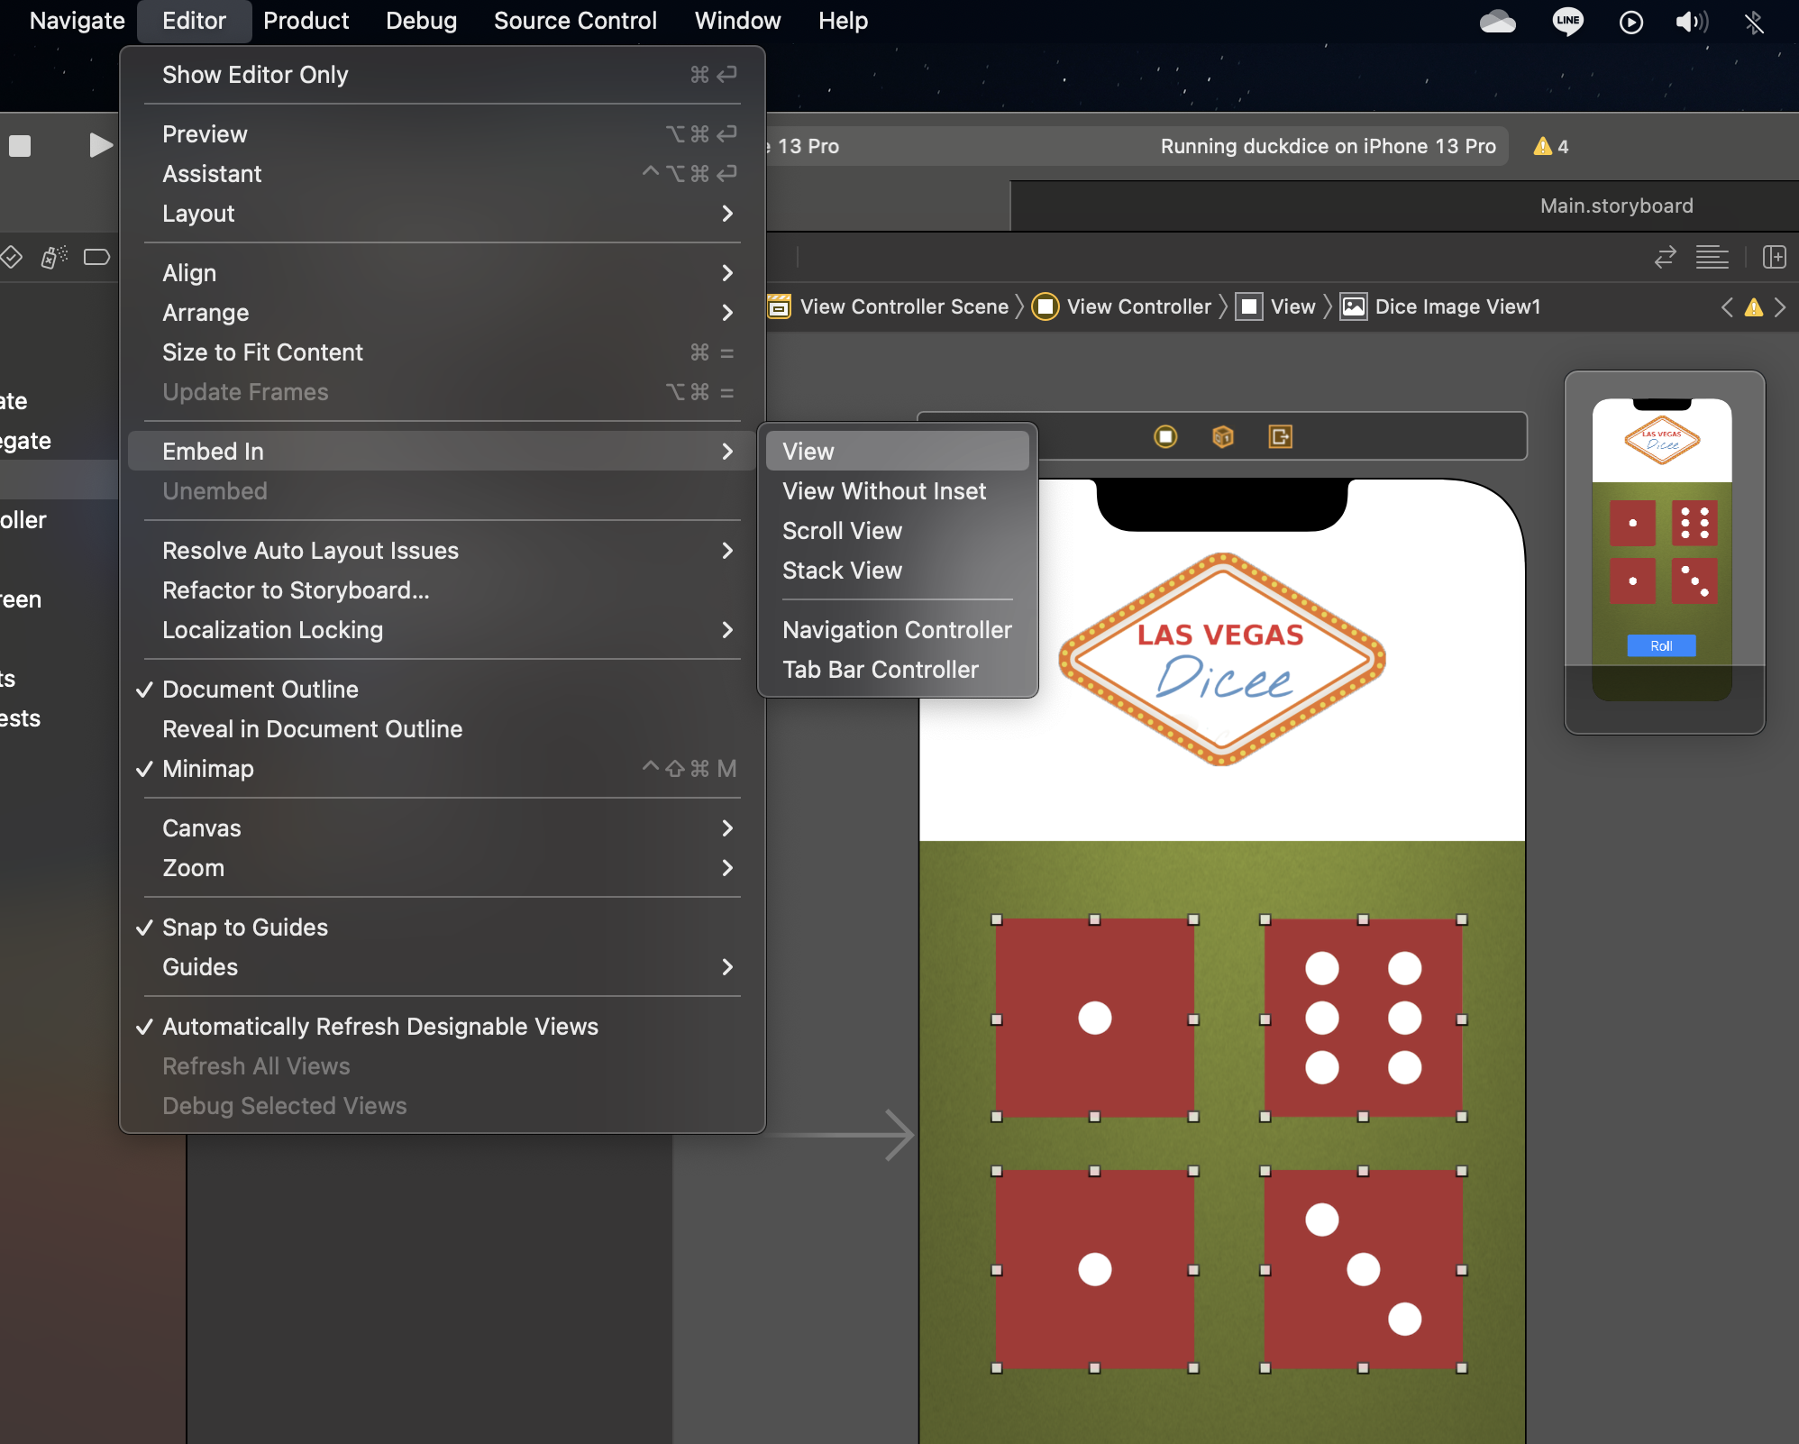
Different Way of Embedding
let's go ahead and embed the dice images.
Choose the dice images, go to Editor and click Embed In, then select a View. now the dice image views have been embedded in its own view and it's the same thing as what we did before.

Slide 15
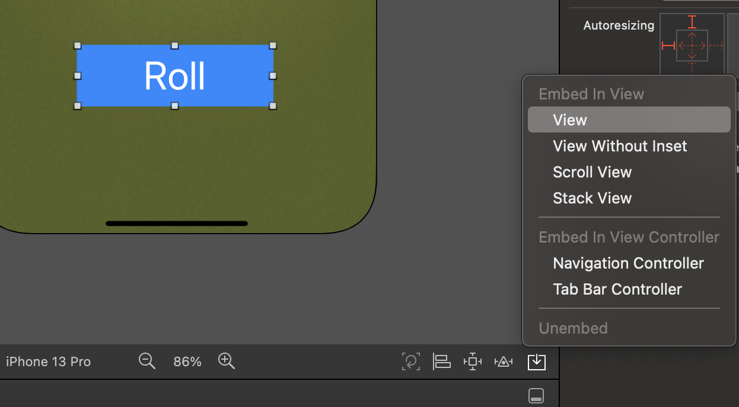
A Third Way of Embedding in A View
Choose our roll button, click on the button showing in the figure, and then click Embed, and then click View.
Depending on which method you remember, or you find the easiest, then you can choose whichever way you want to do it, but they all do the same thing.

Slide 16
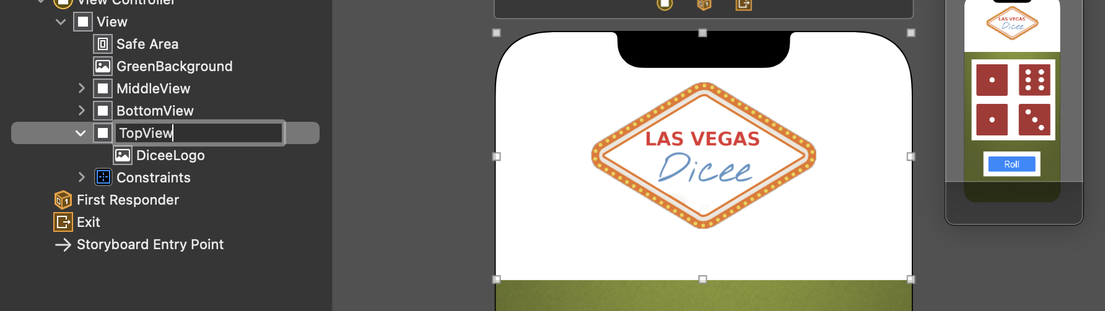
Renaming The Views
Now we have three views and they're all called View, so it's a little bit confusing.
We can select the view, and then click on the Identity Inspector and give it a label, for example, we can call them MiddleView, TopView, BottomView.

Slide 17
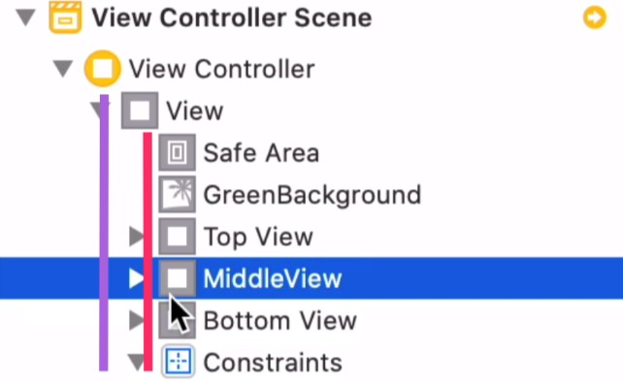
Hierarchical View
Now we should have all of them aligned to the same indentation showing that none of these are inside each other, but they are all inside the superview.

Slide 18
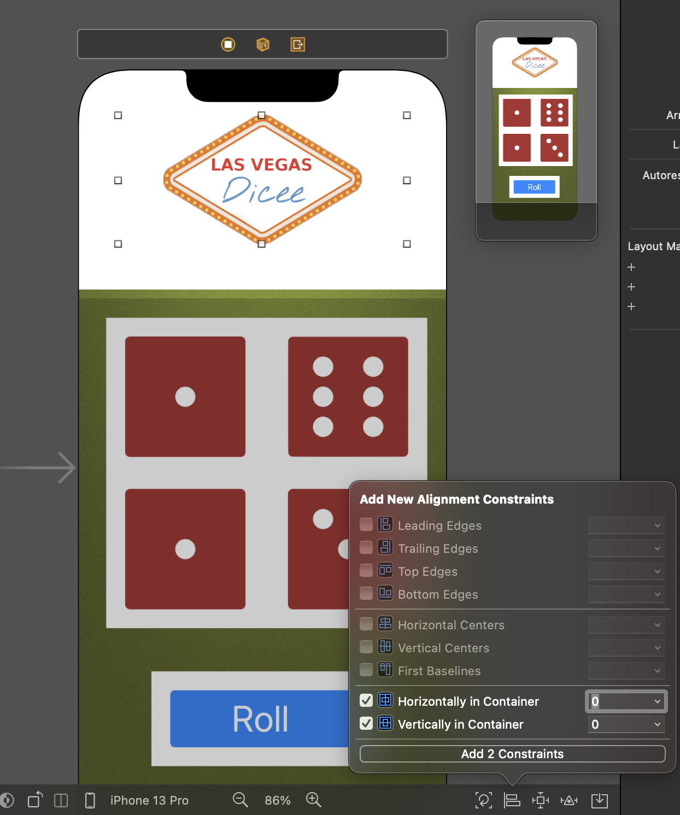
Add Constraint to The Container
Now we have all three containers which can now be used to layout these subviews or these items that are inside it.
For example, the Dicee logo can now be aligned to the horizontal and vertical center of that Top view.

Slide 19
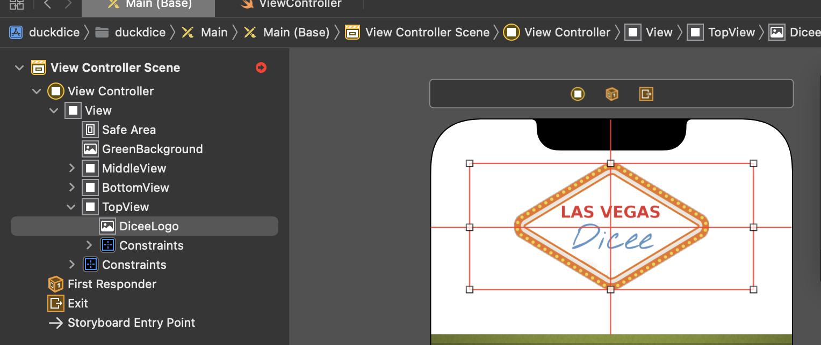
Alignments Errors
Notice that as soon as we do that, we get an error.
If we click on this button, it tells us what the problems are.

Slide 20
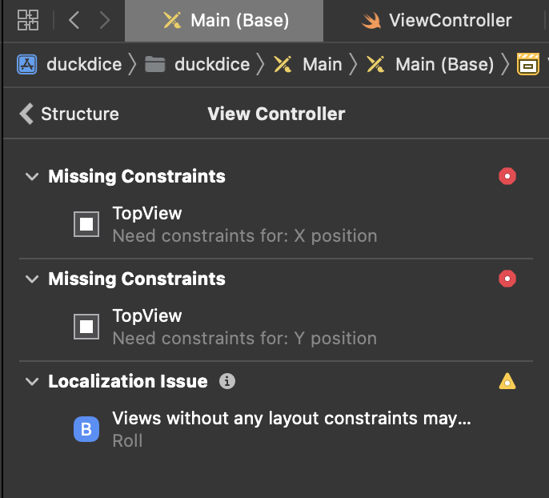
What is The Error?
The errors is that because even though we've defined the constraints for the logo, the location of this container view is kind of ambiguous - we don't know where to put it for its X position or for its Y position because it's currently kind of just hanging out in the middle without any Constraints of its own.

Slide 21
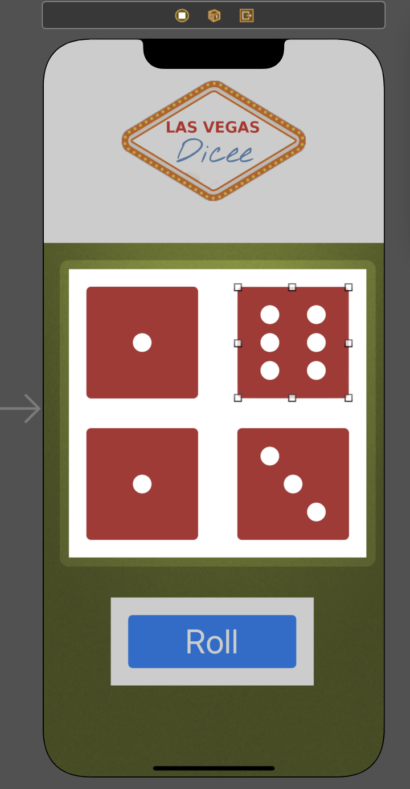
Solve Alignments Errors
The problem is that we haven't given these containers any dimensions or positions of their own.
We haven't specified how they themselves are going to be laid out which is why if we add some constraints to the subviews or the things that are inside these containers, well, it's still ambiguous because it doesn't know how to layout these containers.

Slide 22
StackViews
In Order to Solve The Problem,
We Introduce The

Slide 23
What is StackViews?
A StackView is exactly the way it sounds, It's a way for us to be able to stack views together vertically or horizontally .
For example, in our case, the three views are vertically stacked on top of each other. Or we could also create horizontal stacks such as our dice views that are horizontally aligned with each other.

Slide 24
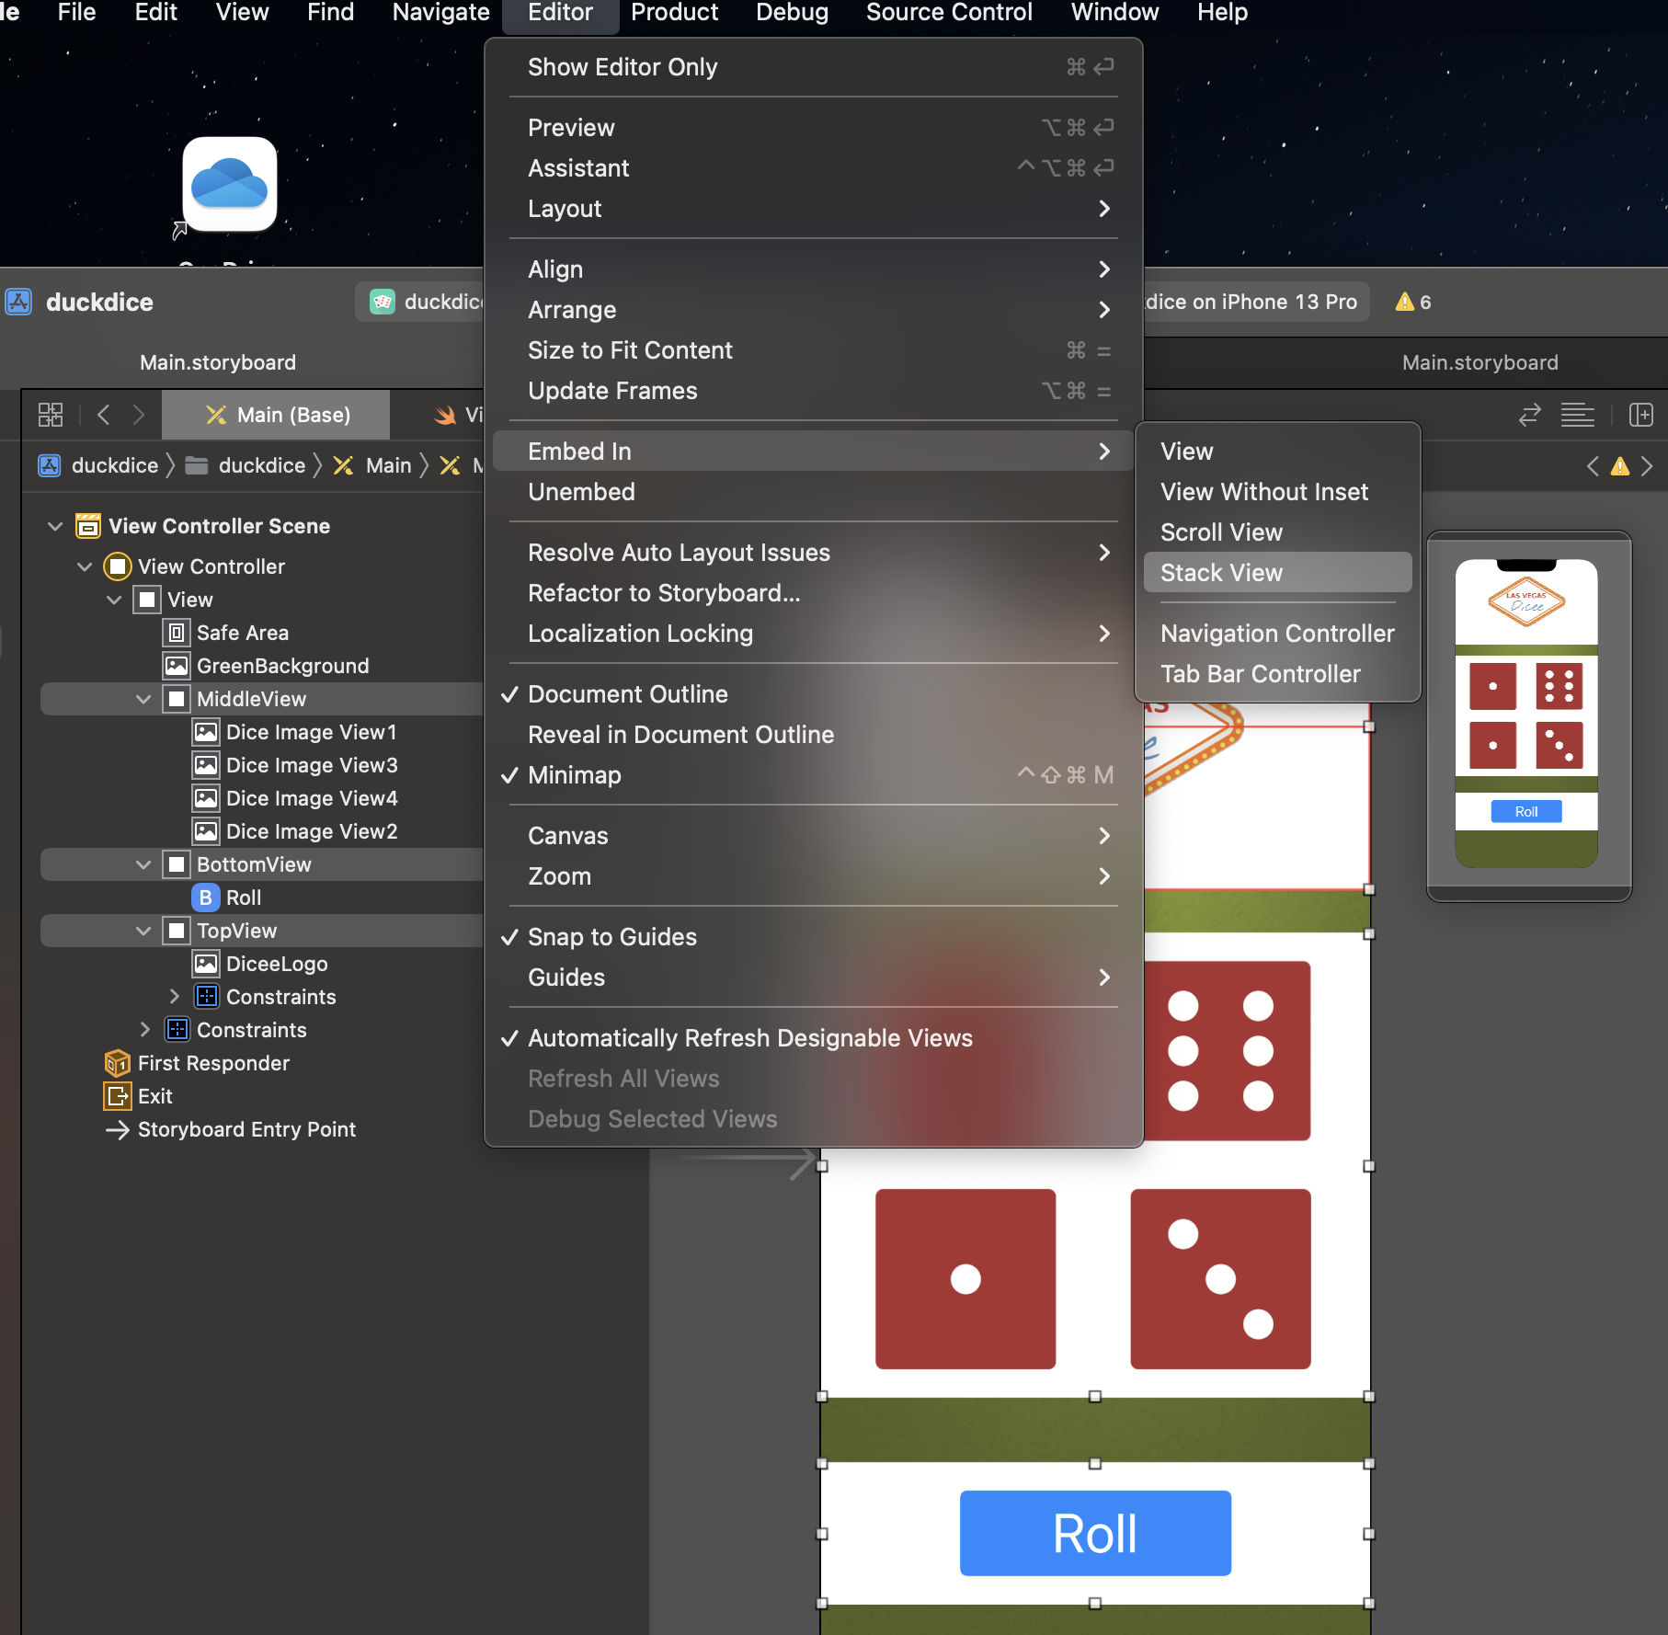
How to Create A StackView?
If we take our Top View and then hold down the command key, and select the Middle View, and the Bottom View, so we have all three selected.
We can go ahead and embed them inside a StackView, so you can go to Editor, Embed in, StackView, or we can simply just select this button and embed it into a StackView.

Slide 25
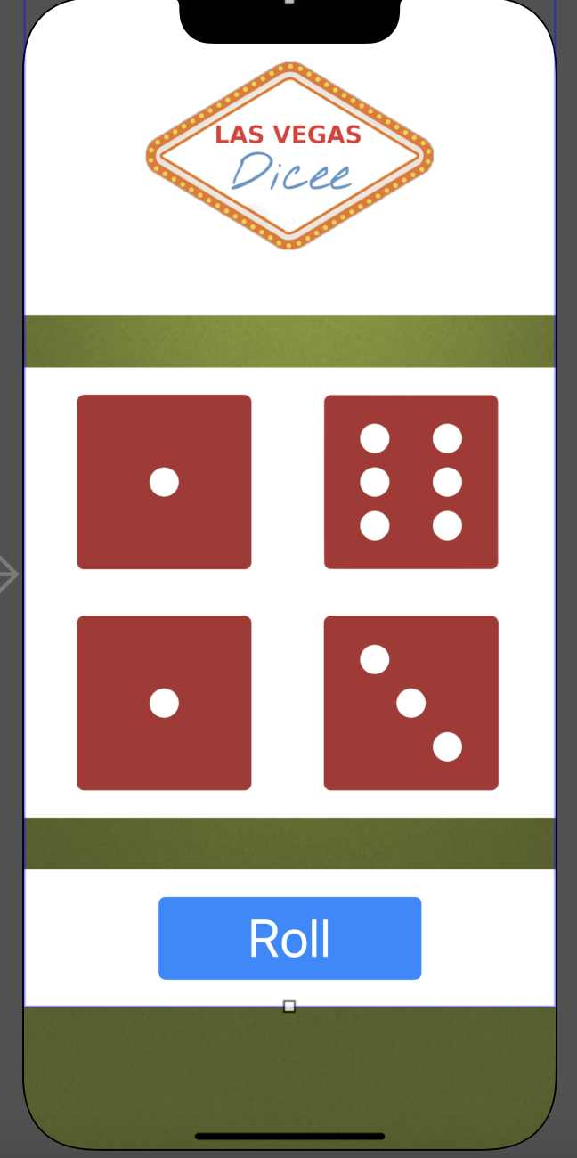
Auto Layout
Now that they are in a StackView, Xcode knows how to align these three things relative to each other.
But we still got some problems because while we know how these three should be placed relative to each other, namely in a sort of horizontal column, we don't know where the StackView begins and ends.

Slide 26
Add Constraints to The StackView
in addition to put these views inside a StackView, we also must give the StackView some constraints relative to its superview.
But this is relatively easy because we want that stack to stretch out so that it takes up the entire screen and to make sure that it doesn't go into the safe areas.
It’s the same constraints we set for the background in previous lesson.

Slide 27
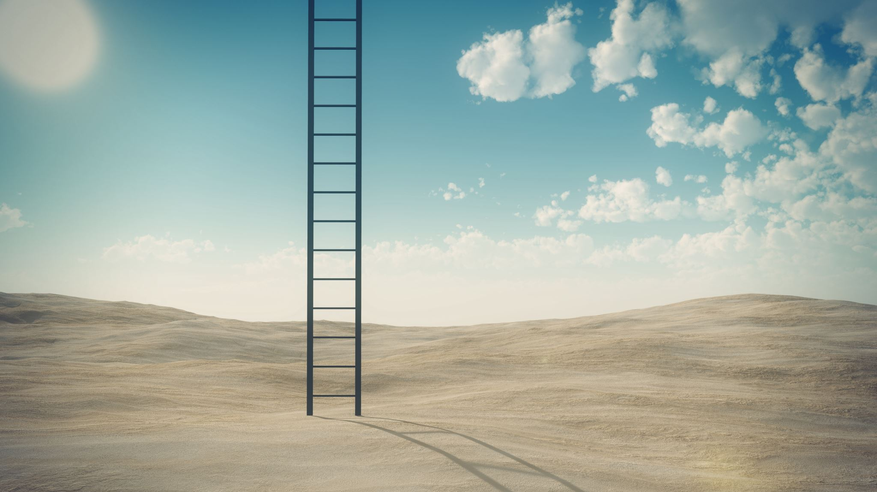
Challenge
1.Think about what you did for the background in terms of setting its constraint.
2.Set the same constraints to the StackView.
3.Let some errors disappeared.

Slide 28
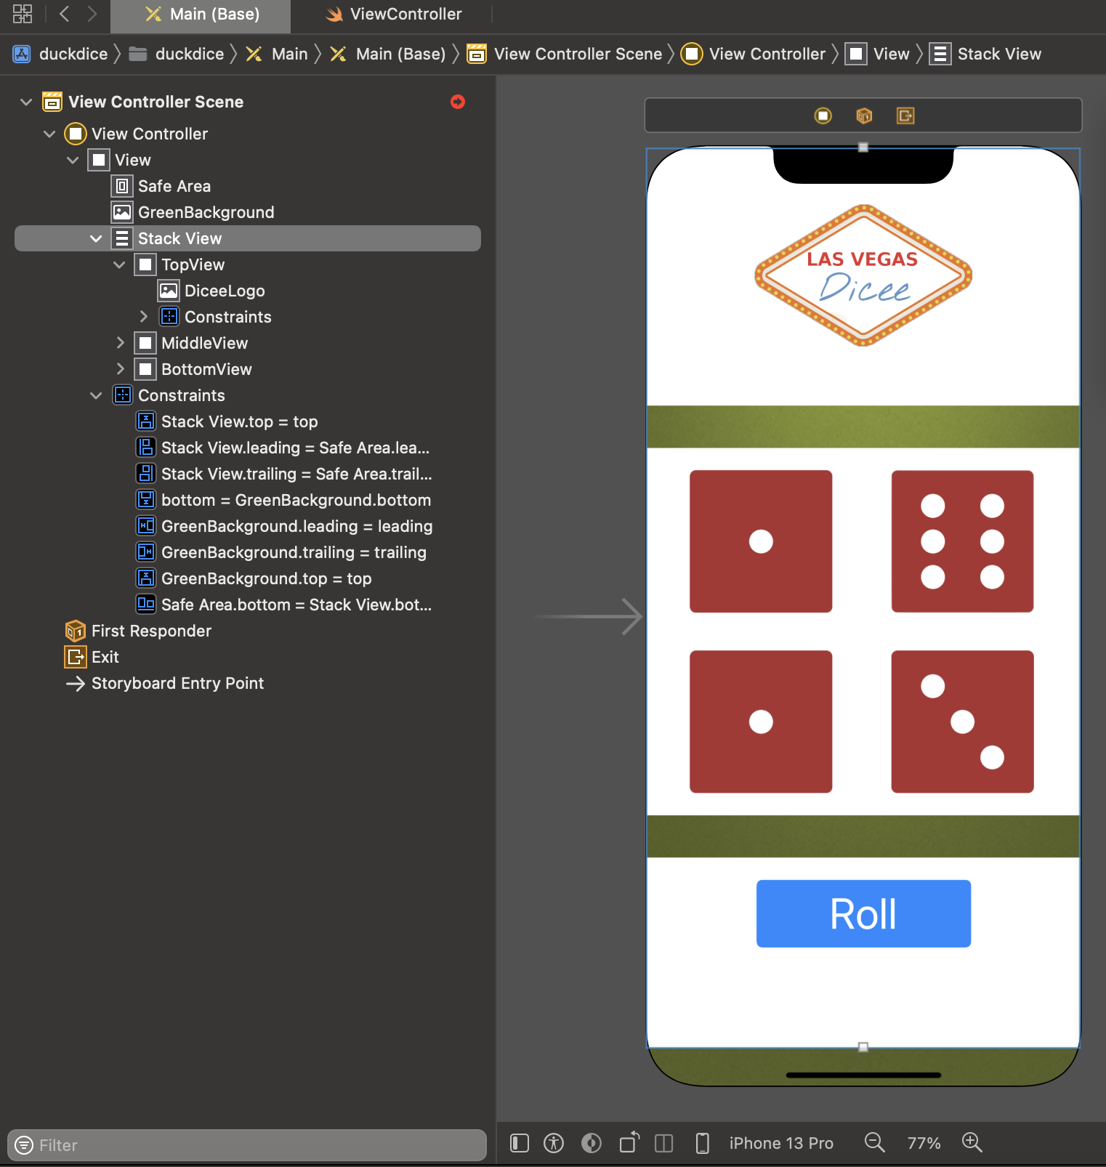
Challenge Results

Slide 29
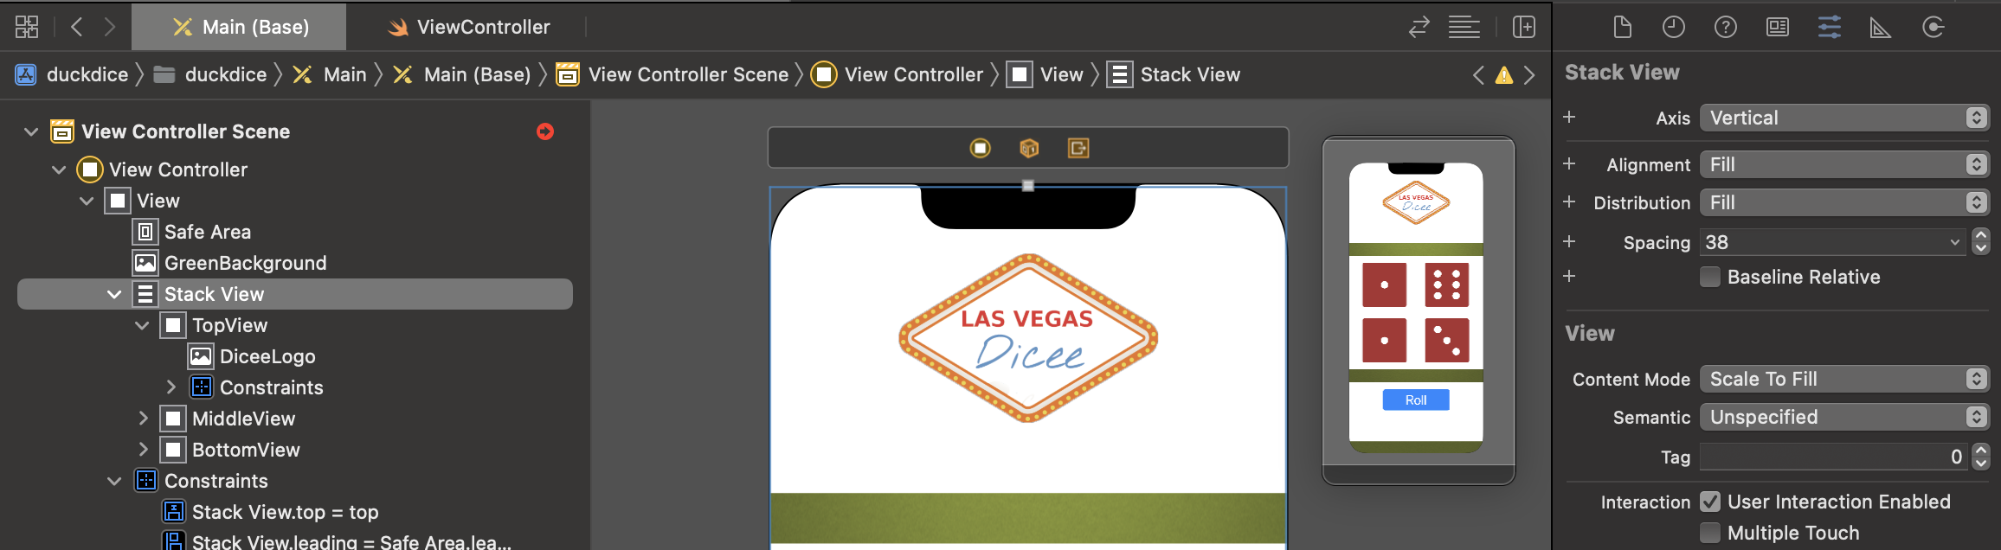
Change The Axis of StackView
After we finished the challenge, we've constrained our StackView to all four sides, the next thing to do is to configure the stack.
Notice when you drop three elements that are roughly vertically on top of each other inside a StackView, it'll automatically choose the vertical axis.

Slide 30
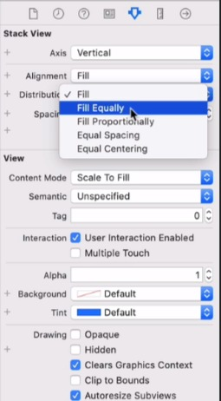
Change The Distribution of StackView
The next thing we're going to do is we're going to change the distribution to fill equally if we want all three of these views that are contained in my stack to have equal heights along the vertical axis.

Slide 31
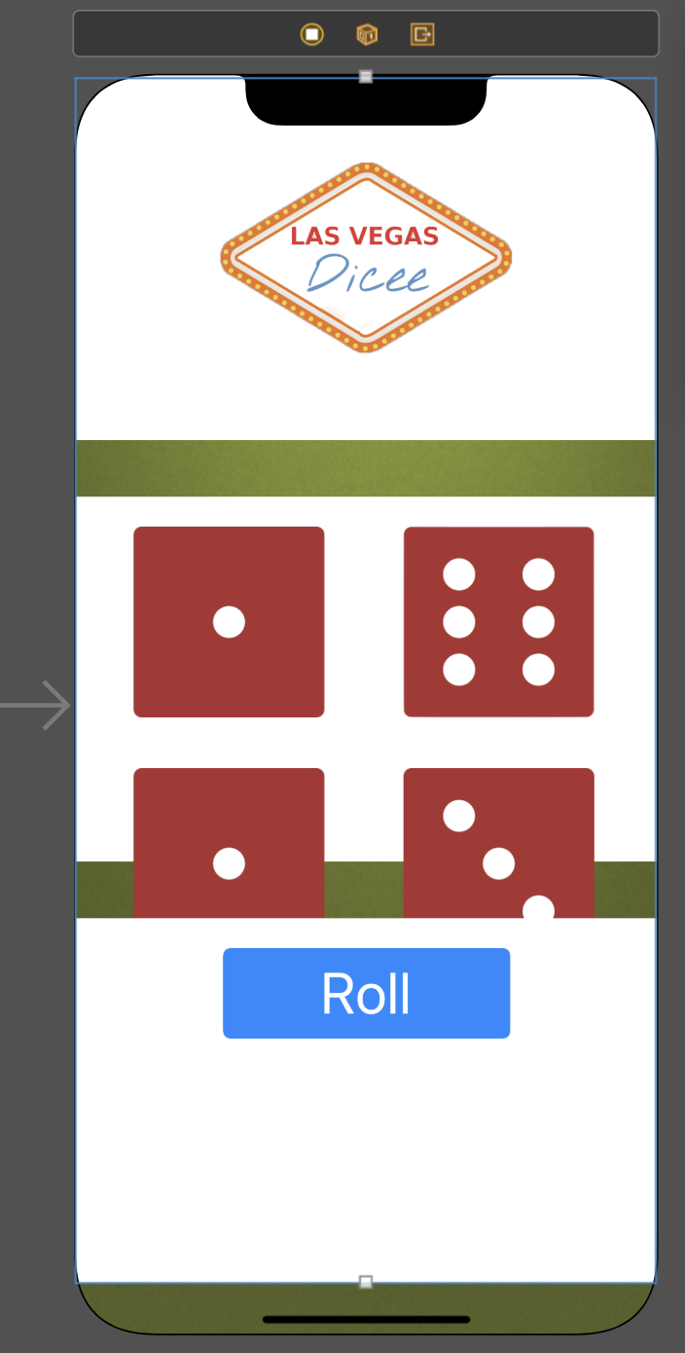
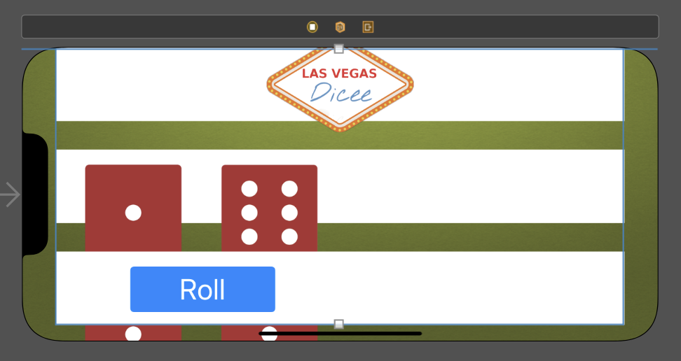
The Errors Disappeared
As soon as we do the previous steps, we'll notice some more errors will go away, and it because we know how to layout these three elements even if it's in a horizontal orientation.

Slide 32
Add Constraints to All The Elements inside The Containers
Now that we've specified our stack, it makes it so much easier to align these other elements.
For example, our Roll button, for example, can now be horizontally and vertically aligned in its container which is the bottom view rather than this one.
So, let's go ahead and add some constraints to all the elements.

Slide 33
Challenge
Think about the dice images, How can we let the two or four dices to be suitable place in the middle container?
Hint: Use StackView and add some Constraints.

Slide 34
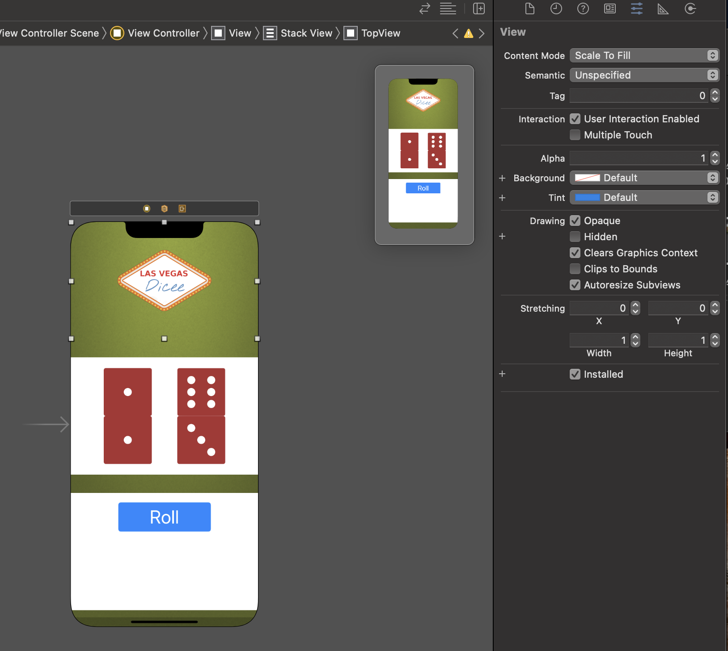
Change The Background of The Views
we can go ahead and select these container views and change the background to default.

Slide 35
Exercise 2
Deadline: 2022/5/15 23:59
Keep working on your app from Exercise 1, Please design an iOS app to play a dice game which can be suitable for every orientations:
Vertically : Make all images, logo and button can be seen in your apps vertically– 40%
Horizontally : Make all images, logo and button can be seen in your apps horizontally– 60%
Please upload a word document to E-learning – Homework/Report contained of following things:
Cover : Exercise number / your name / your student ID
Content : Your project’s navigator(專案架構)/ Storyboard / ViewController, please describe it as detail as you can by the snapshot and source code
Result : please illustrate the buttons and functions you have done in your project from snapshots
Free Style is Allowed

